Slide 1
Radioactive Decay

Slide 2
Radioactive decay
Atoms are called radioactive if their nucleus is unstable.
As protons are all positively charged, according to Coulombs law, they should repel each other and fly apart. This does not happen.
The strong nuclear force holds the nucleus of an atom together, and is an attractive force over small distances.

Slide 3
Strong force continued
If the force was only attractive then it would pull the protons and neutrons together to an ever decreasing small volume of space.
We know this not to be the case as each nucleus contains a distinct number of protons and neutrons which retain their identity.
The more protons and neutrons, the bigger the nucleus and thus the separation between the protons and neutrons in a nucleus must be a fixed distance.
This means the strong nuclear force must be repulsive at a very small range as well as being attractive over a slightly larger distance.

Slide 4
Unstable nucleus
If the repulsive forces within a nuclei are larger than the attractive forces, the nucleus will break apart.
These nuclei where the forces are unbalanced are known as unstable.

Slide 5
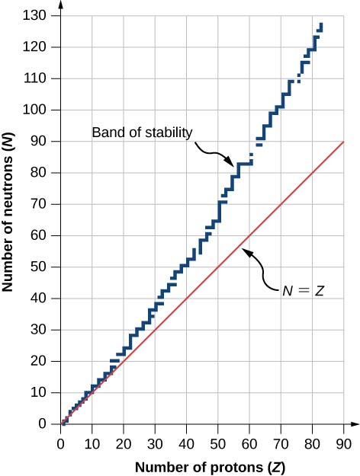

Slide 6
Radioactive atoms can emit α or β particles that have mass, or massless γ rays.
As a result of α or β emission, the radioactive element turns into an atom of a different chemical element.

Slide 7
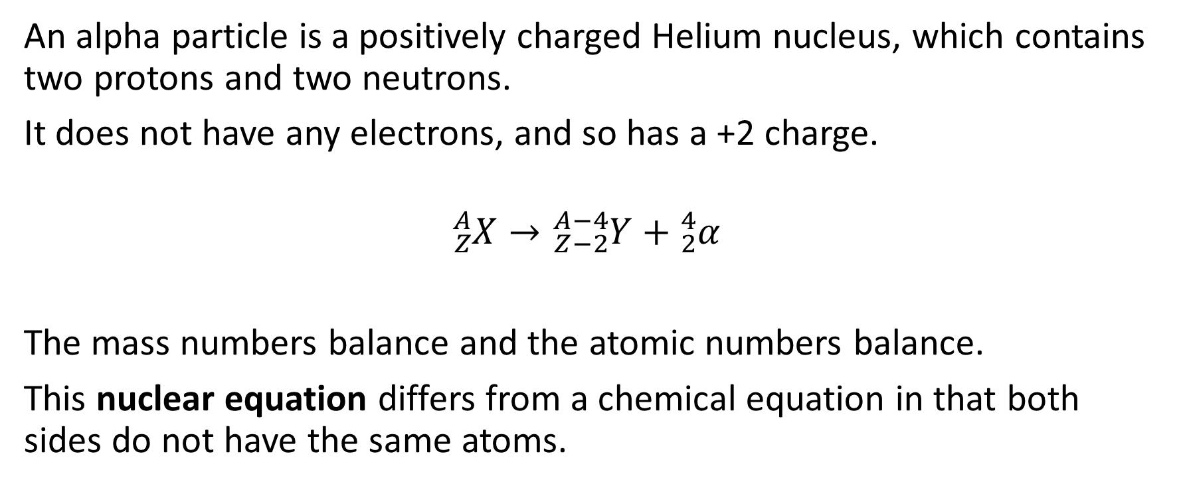
Alpha
An alpha particle is a positively charged Helium nucleus, which contains two protons and two neutrons.
It does not have any electrons, and so has a +2 charge.
$${}_{Z}^{A}X→{}_{Z−2}^{A−4}Y+{}_{2}^{4}α$$
The mass numbers balance and the atomic numbers balance.
This nuclear equation differs from a chemical equation in that both sides do not have the same atoms.

Slide 8
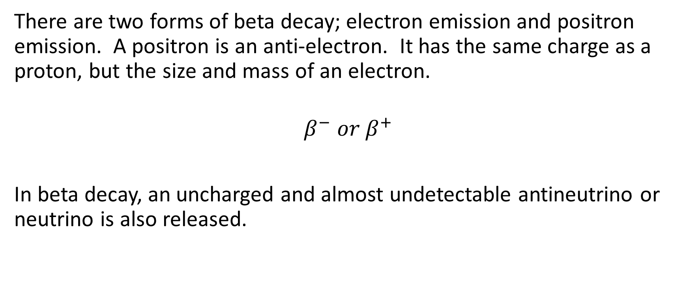
Beta
There are two forms of beta decay; electron emission and positron emission. A positron is an anti-electron. It has the same charge as a proton, but the size and mass of an electron.
$$β^{−} or β^{+}$$
In beta decay, an uncharged and almost undetectable antineutrino or neutrino is also released.

Slide 9
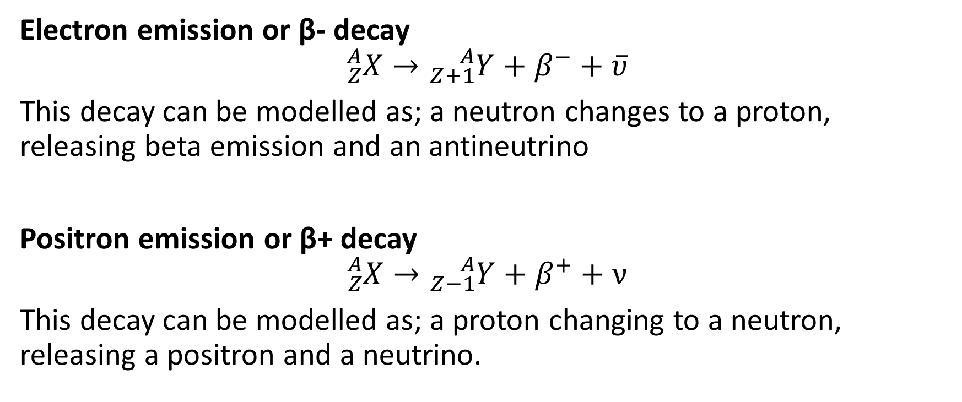
Electron emission or β- decay
$${}_{Z}^{A}X→{}_{Z+1}^{A}Y+β^{−}+\overline{υ}$$
This decay can be modelled as; a neutron changes to a proton, releasing beta emission and an antineutrino
Positron emission or β+ decay
$${}_{Z}^{A}X→{}_{Z−1}^{A}Y+β^{+}+ν$$
This decay can be modelled as; a proton changing to a neutron, releasing a positron and a neutrino.

Slide 10
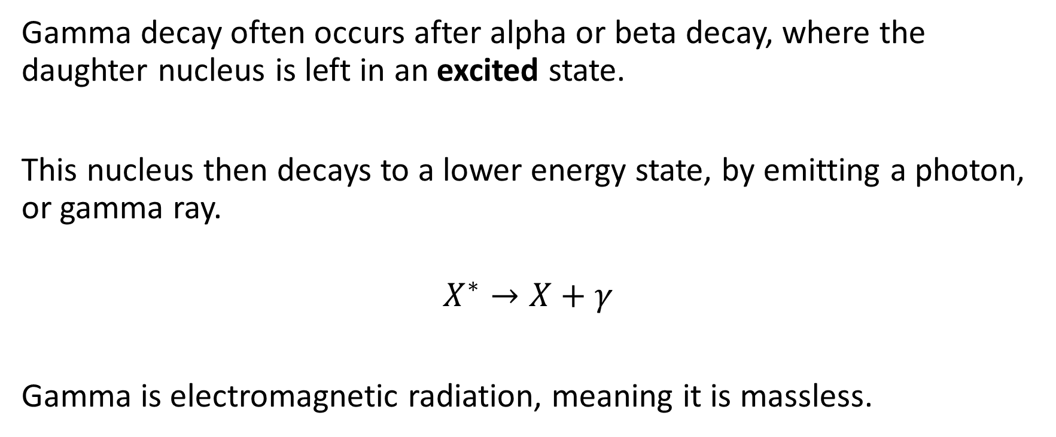
Gamma
Gamma decay often occurs after alpha or beta decay, where the daughter nucleus is left in an excited state.
This nucleus then decays to a lower energy state, by emitting a photon, or gamma ray.
$$X^{∗}→X+γ$$
Gamma is electromagnetic radiation, meaning it is massless.

